Slide 1
Math analysis
Day 29

Slide 2
Objective
Finish your replica of a “Real Life” image that isn’t already pixelated.
Finish begin to create Space Filling Curves
Begin Presentation…

Slide 3
Saving Your Image:
In Bricklayer Lite Level 3
Save your object as Name_Real_Image.xml
To Turn In Folder: 12_Real_Image_Formative
Save to One Drive and/or Flashdrive!!!

Slide 4





Schools

Slide 5







Brands

Slide 6
Saving Your Image:
In Bricklayer Lite Level 3
Save your object as Name_Curves.xml
To Turn In Folder: 13_Space_Filling_Curves_Formative
Save to One Drive and/or Flashdrive!!!

Slide 7
Background on Wunderlich Curves
The Wunderlich curves are a collection of plane-filling curves, similar to the Hilbert and Moore curves. Each Wunderlich curve begins with a seed shape, and each successive iteration translates-rotates-reflects copies of the seed in a 3×3 grid in such a way that the end of one copy is next to the beginning of the next copy.
The first type begins with an S-shape, which winds from the southwest corner of its bounding square to end up in the northeast corner:
http://www.robertdickau.com/wunderlich.html

Slide 8
Goal: Create the Wunderlich Curve to fill a 128x128 screen
The next few slides will act as a preview for what you will be doing today…

Slide 9
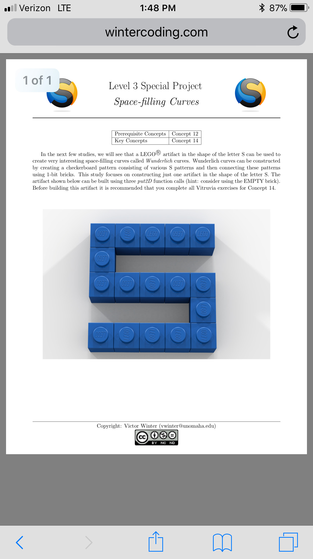
Goal: Start with a single ‘seed’ that will be replicated later on

Slide 10
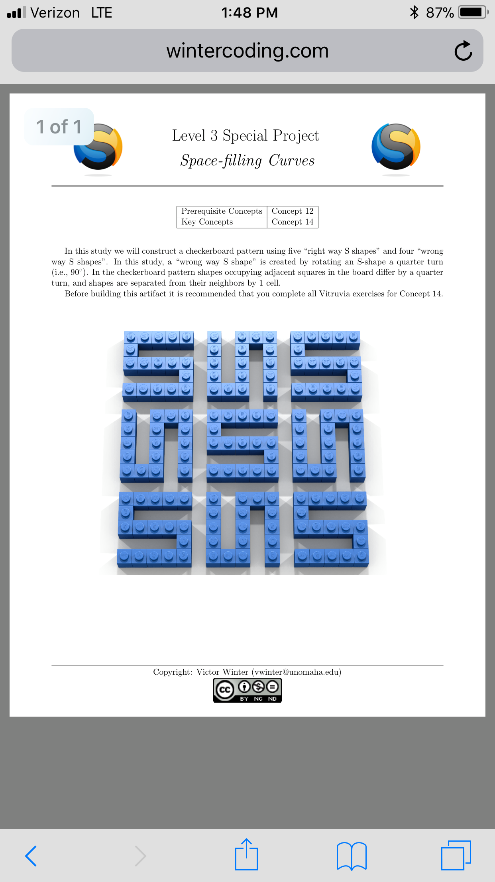
Goal: Be able to have the rotations of the ‘seed’ available through alternate function calls or however you see fit.

Slide 11
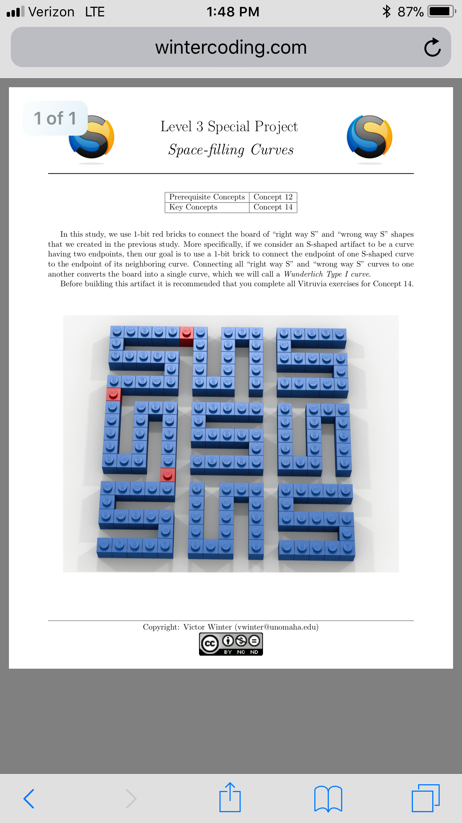
Goal: Connect the ‘seeds’ together in order to form a non stop curve… where the end of one seed touches the start of the next

Slide 12
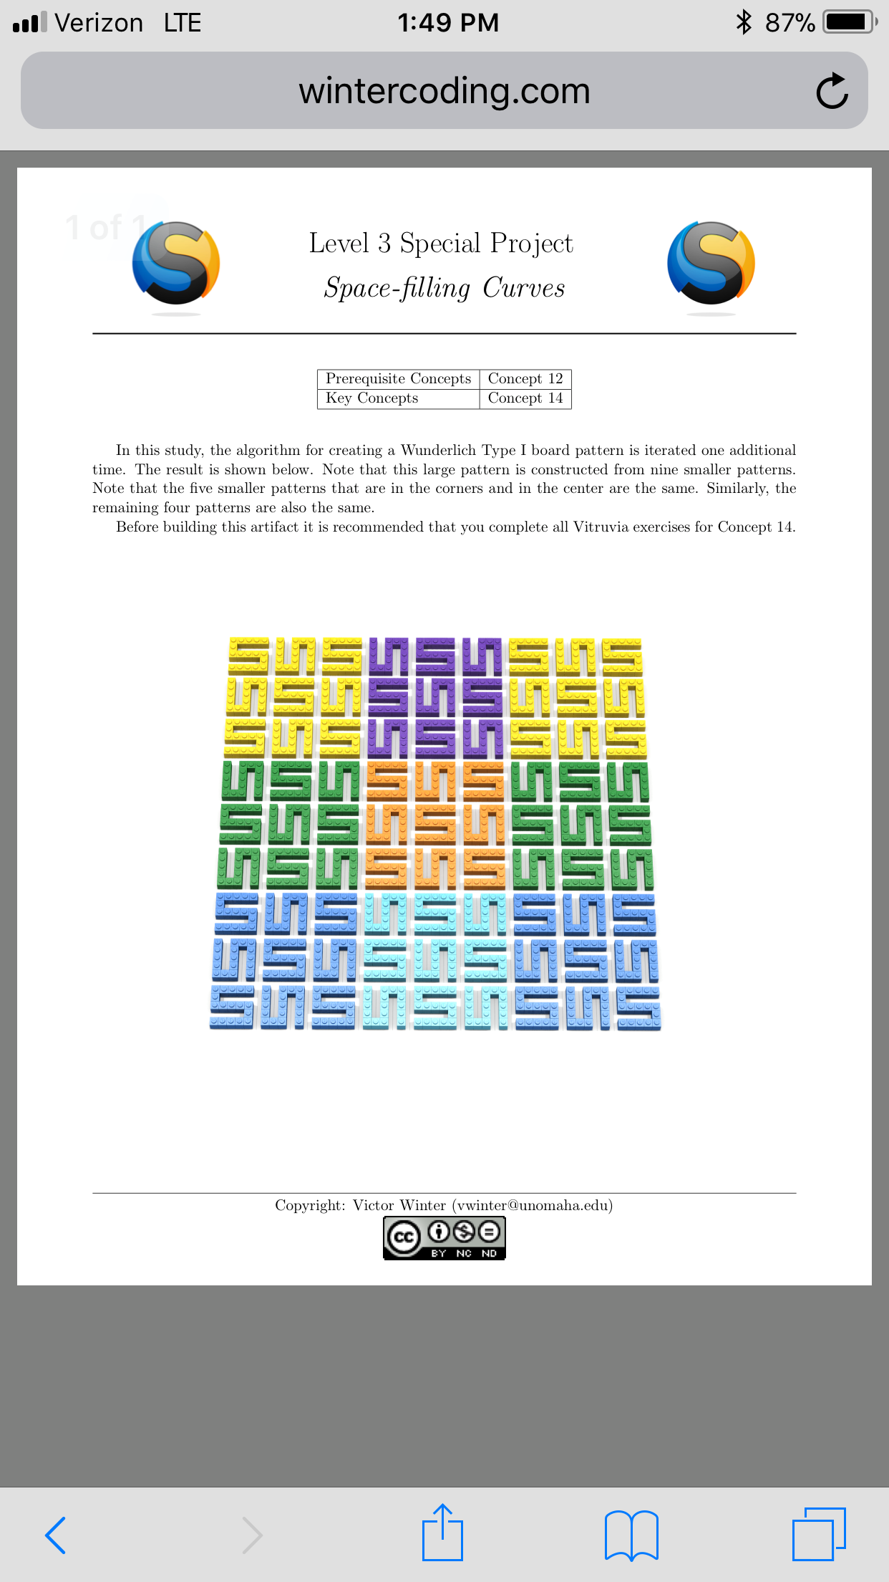
Goal: Repeat this 3x3 pattern to fill in the rest of the screen. Challenge: Alternate the color to separate the 3x3 patterns

Slide 13
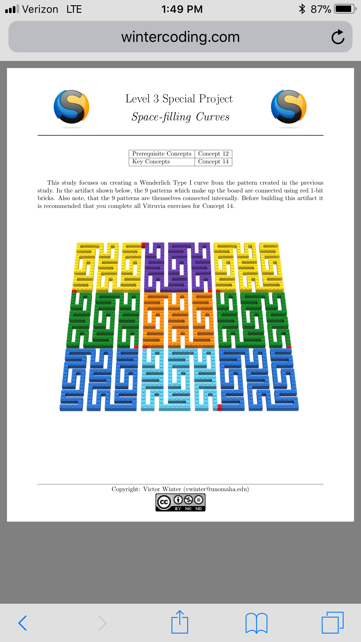
Goal: Connect the 3x3 patterns to form one large curve that fills the entire screen

Slide 14
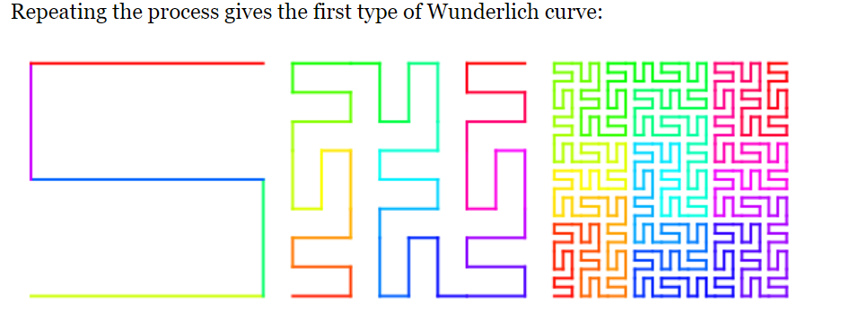
Expand on this Concept:

Slide 15
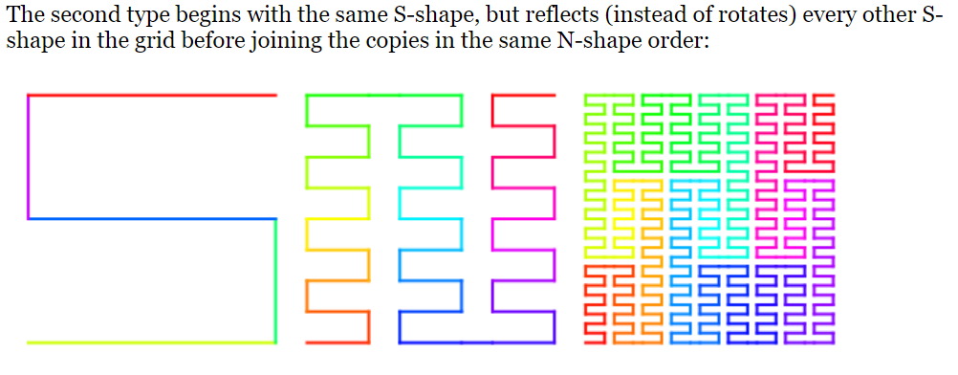
Expand on this Concept:

Slide 16
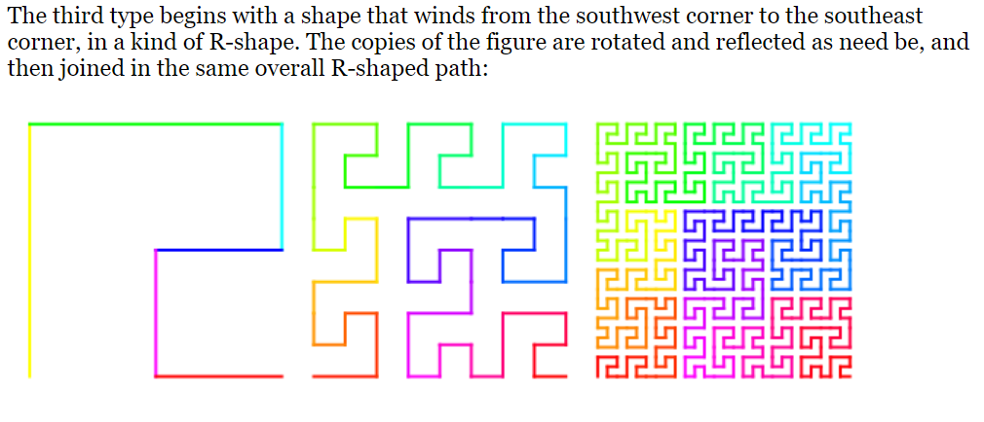
Expand on this Concept:

Slide 17
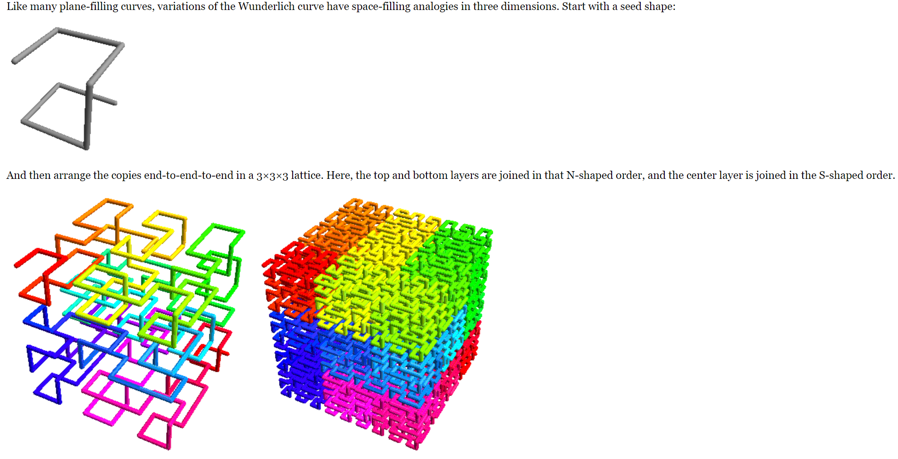
Wunderlich in 3D

Slide 18
Presentations:
How to use the “Snipping Tool”
Download your previous code from all past assignments
Grab a screen shot of the image from The Grid or Bricklayer Lite
Grab a screen shot of a piece of the “code” from each image that shows a continued pattern through out, something you would improve upon now that you know more, and/or a common theme
Begin formatting your ‘thoughts’ for the essay portion of this grade… (in other words put into words the previous point)

Slide 19
Review Saving in Bricklayer Lite to Teams
Change “Filename” make sure it ends with .xml
Click Download XML
Open up Teams
Open the appropriate folder: ______________________
Click “upload” and select your recently downloaded file
Save
*Move the file to your One Drive from your Downloads folder

